Slide 1


Nonlinear Differential Equations from a Vector Model of Lorentz Symmetry Breaking
Dario Walter-Cardona, Dr. Quentin Bailey
Arizona NASA Space Grant Consortium
Bumblebee gravity: spherically-symmetric solutions away from the potential minimum
Bailey, Murray, Walter-Cardona, arXiv: 2503.10998

Slide 2

Acknowledgments
Dr. Bailey, Hailey Murray, Sawyer Star
Dr. Boettcher

Slide 3
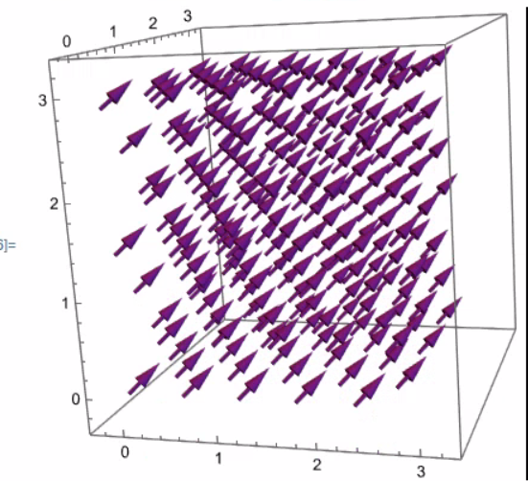
What is Lorentz Symmetry?
General Relativity: Spacetime curves
Special Relativity: Experimental outcomes are the same regardless of the inertial frame
Lorentz transformations; rotations and boosts
Lorentz symmetry can be broken in a unified theory of physics
LSV are described as a background field in empty spacetime
Notes:
So we’ll be adding a new term to our model that represents this symmetry breaking background field in empty spacetime.
Testing our framework (The SME is the framework)

Slide 4




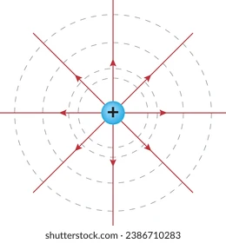

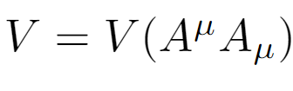
The Bumblebee Model and The Flat Spacetime Limit
Assuming Spherical Symmetry: (Bailey, Murray, 2023)
Original bumblebee model (Kostelecky and Samuel PRD 89’)
Flat Spacetime- In the absence of gravity
Notes:
(Physical Review D) Using a vector model of spontaneous symmetry breaking in flat space time:
V is the potential energy function for the A nu vector field.
The Bumblebee Model
Einstein Field Equations T (Stress Energy Tensor)
Semicolon: is the covariant derivative
We just use the zero component of the “tensor”
The potential V is a function of -A_0^2,
Vector Potential, Bumblebee Field, V’ is the derivative of the potential with respect to its argument
Divide A_0 by lambda to make it unitless, everything is relative to lambda (We use a length scale associated with the minimum value of the potential to make our variables dimensionless)

Slide 5
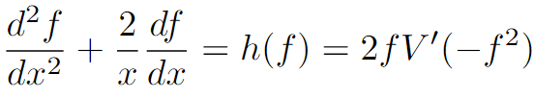
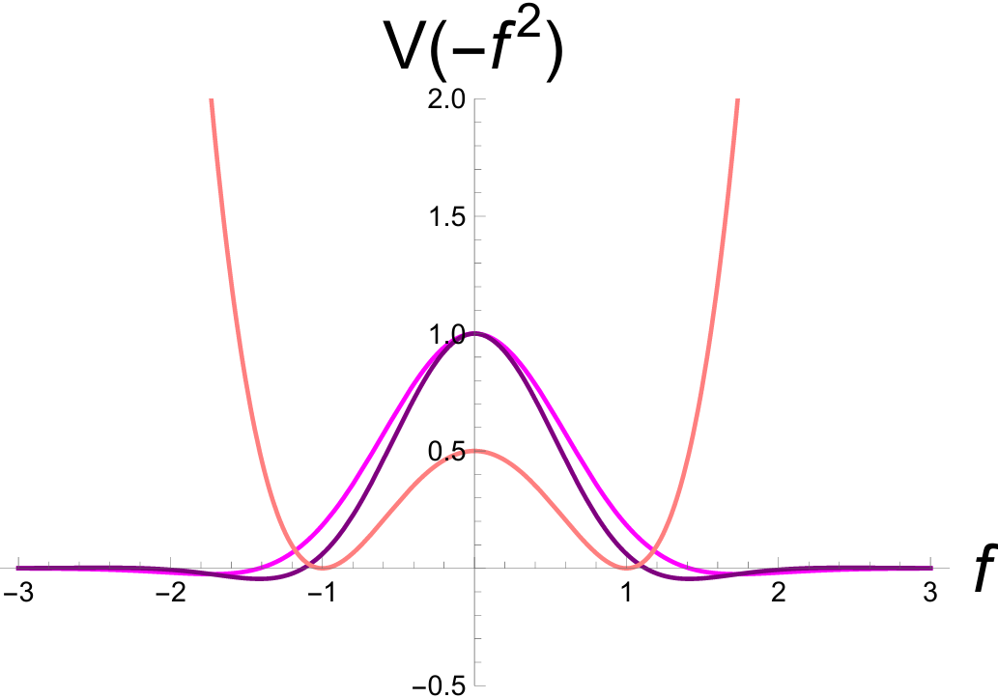
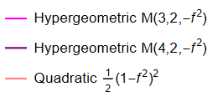
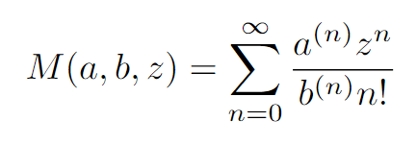
The Quadratic and Hypergeometric Potential Models
-Quadratic function or Kummer Confluent Hypergeometric functions
- Creates a nonautonomous second order nonlinear ODE
Notes:
Kummer Confluent Hypergeometric Function, to be precise. The a^(n) is the rising factorial, NOT an exponent. The points of Stability is when the Potential energy doesn’t change. Ideally, as we get farther away from our point of origin, the potential should stabilize

Slide 6
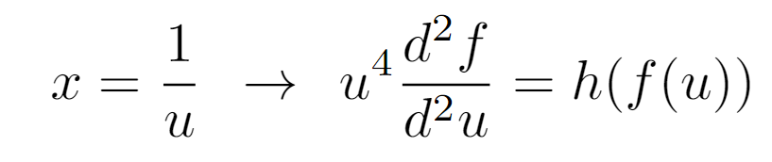
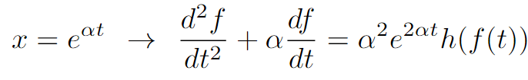
Useful Various Substitutions
Why it Helps
As u → 0, x → ∞
t → ∞ “faster” than x

Slide 7

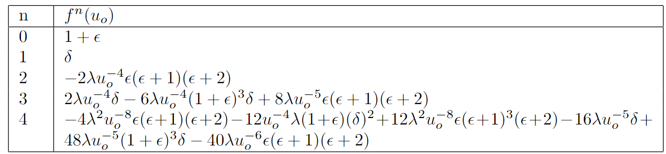
Analytical Solution: Using a Taylor Series (Quadratic Case)
Use the x=1/u substitution to simplify calculations:
Coefficients for the Taylor series centered near point of stability
Notice that if 𝜖 and 𝛿 are zero, all subsequent derivatives are zero.
Notes:
Otherwise, there doesn't seem to be any clear pattern to describe the behavior of “f”

Slide 8
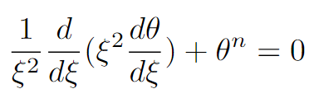
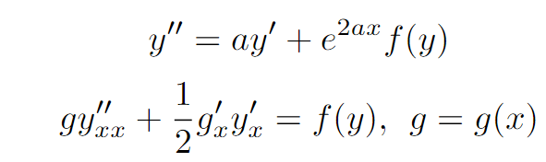
Comparing to known analytical solutions- Uniqueness
The Lane-Emden Equation, has analytical solutions for n=0,1,2,5
Polyanin and Zaitsev’s Equation 2.9.2.17, Handbook of Exact Solutions for Ordinary Differential Equations

Slide 9
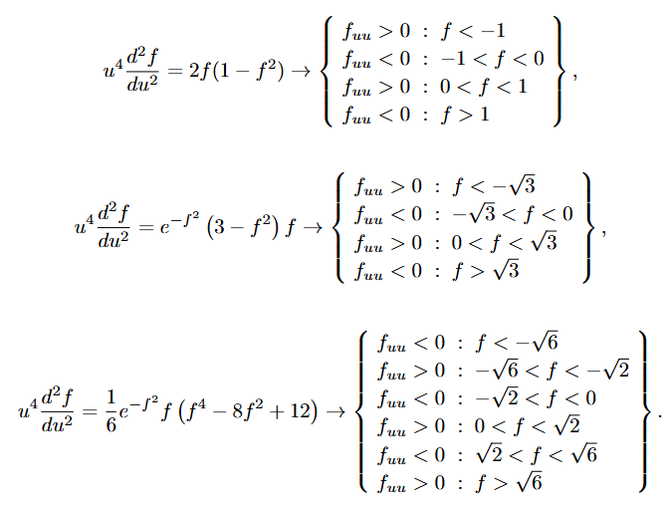
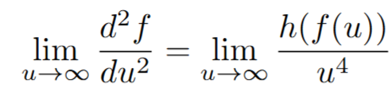
Analytical Argument for Stability
Quadratic
-Use the x=u⁻¹ substitution to make generalized statements about f_{uu}
- u⁴ is always positive, the sign on the right hand side of the equation corresponds directly to the concavity of the solution
Hyper 3
Hyper 4

Slide 10
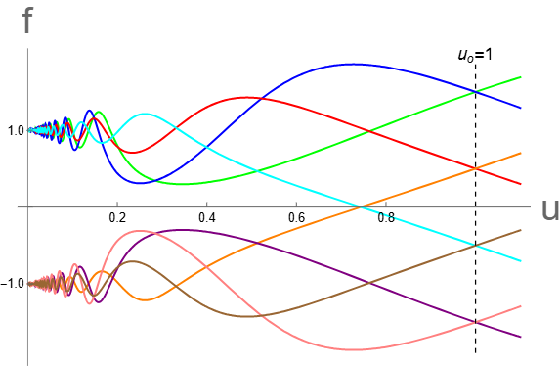
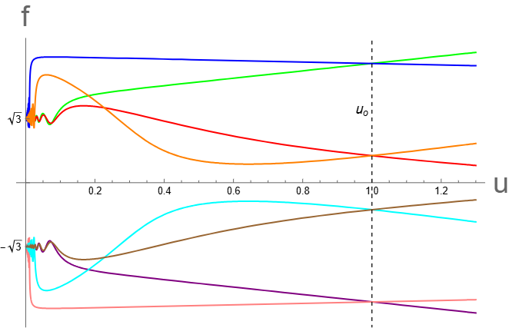
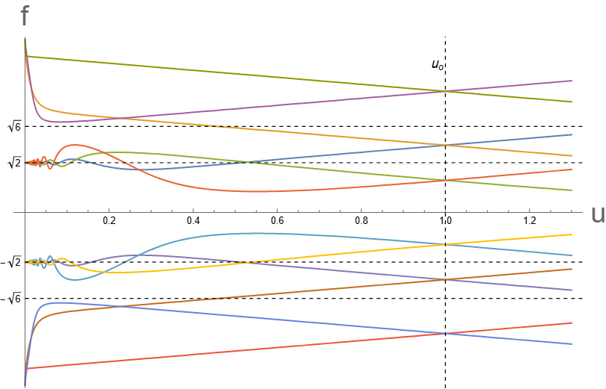
Numerical Solutions
Quadratic
Hypergeometric 3
Hypergeometric 4

Slide 11
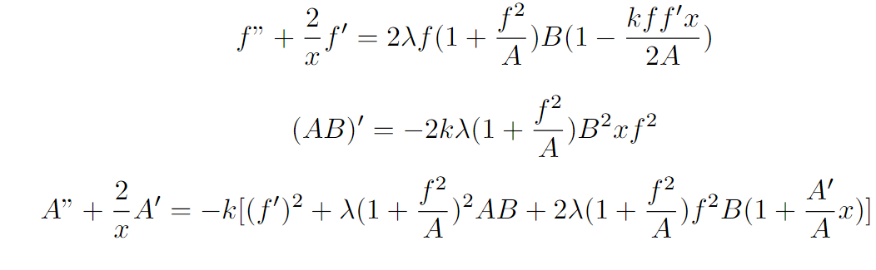
Conclusions and Future Work
Bumblebee gravity: spherically-symmetric solutions away from the potential minimum
Bailey, Murray, Walter-Cardona, arXiv: 2503.10998
Demonstrated the stability of Quadratic and Hypergeometric forms of the symmetry breaking potential.
Curved spacetime solutions, accounting for gravitational potential. (Hailey Murray)
Add a charge distribution to the Einstein Maxwell Field equations.
Analytical solution
Proving that some forms of the Hypergeometric potential are stable when others aren’t

